Slide 1


COLLEGE OF ENGINEERING, GUINDY ANNA UNIVERSITY, CHENNAI - 25
DEPARTMENT OF COMPUTER SCIENCE AND ENGINEERING
SignBridge India A Bidirectional Indian Sign Language Translation System
Submitted By
Under the guidance of
Dr. C. Valliyammai
Professor
Department of Computer Science and Engineering
2023103046 | Rajesh A
2023103546 | Kathir Kalidass B
2023103579 | Sathyanarayanan P
2023103703 | Nandha S

Slide 2
Introduction
Indian Sign Language (ISL) is the primary mode of communication for a large deaf and hard-of-hearing population in India.
Most digital platforms and public information systems are designed for hearing users and rely on spoken or written languages.
Existing sign language translation systems largely focus on foreign sign languages and lack support for Indian Sign Language.
Many available systems do not provide bidirectional or real-time translation capabilities.
This creates a significant communication gap between ISL users and English-based digital systems.
The proposed system aims to enable two-way translation between Indian Sign Language and English to support inclusive communication.

Slide 3
Objectives
To design a bidirectional translation system between Indian Sign Language and English.
To enable conversion of Indian Sign Language gestures into English text and audio.
To generate Indian Sign Language representations from English text or speech.
To support inclusive communication between deaf and hearing individuals.
To improve accessibility in educational, public service, and digital environments.
To ensure the system is scalable and adaptable to Indian linguistic diversity.

Slide 4
Literature Survey
S. No. | Paper | Methodology | Limitations
1 | iSign: A Benchmark for Indian Sign Language Processing, arXiv, 2024 [1] | Large-scale ISL–English video–text paired dataset Baseline deep learning models for recognition and translation tasks | Focuses on dataset benchmarking Does not provide a full real-time end-to-end system
2 | Real-Time Vision-Based Indian Sign Language Translation Using Deep Learning Techniques, IJIRCST, 2025 [2] | CNN-based spatial feature extraction LSTM and Transformer-based encoder–decoder models DTW for gesture sequence normalization | Limited dataset diversity High computational cost for real-time deployment
3 | A Survey on Vision-Based Sign Language Recognition Using Deep Learning, IEEE Access, 2024 [3] | Comprehensive review of CNN, LSTM, Bi-LSTM, and Transformer models for SLR Analysis of vision-based sign language systems | Continuous sign language translation remains under-explored Lack of standardized ISL benchmarks

Slide 5
S. No. | Paper | Methodology | Limitations
4 | Multimodal Sign Language Translation Using Vision and Language Models, Elsevier Neurocomputing, 2024 [4] | Fusion of visual features with language representations Multimodal deep learning framework for sign translation | Not specific to Indian Sign Language Increased complexity affects real-time performance
5 | Transformer-Based Continuous Sign Language Translation, ACM Multimedia, 2024 [5] | Transformer-based sequence-to-sequence modeling Attention mechanisms for continuous sign language translation | Requires large-scale annotated datasets Computationally expensive for live systems
6 | Vision-Based Continuous Sign Language Translation with Deep Learning, Springer Multimedia Tools and Applications, 2025 [6] | End-to-end vision-based sign language translation Deep learning models for spatio-temporal gesture modeling | Performance drops in unconstrained environments Limited signer-independent evaluation

Slide 6
Proposed System & Overall Architecture
Bidirectional Indian Sign Language ↔ English translation system
Supports ISL video, English text, and English speech inputs
ISL → English: Gesture detection, feature extraction, sequence modeling
English → ISL: Text/speech normalization and sign synthesis
Bidirectional flow controller manages translation direction
Backend services handle model inference and data storage

Slide 7
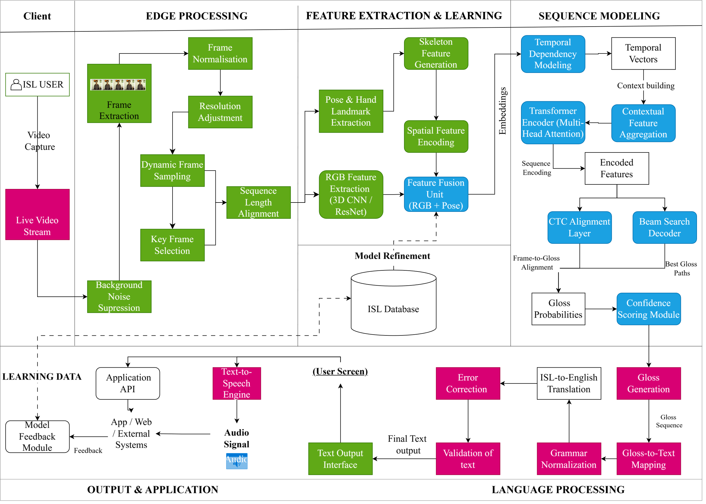



Slide 8
System Modules Overview
Video Acquisition & Preprocessing
Feature Extraction & Fusion
Continuous Sign Recognition
Language & Audio Output

Slide 9
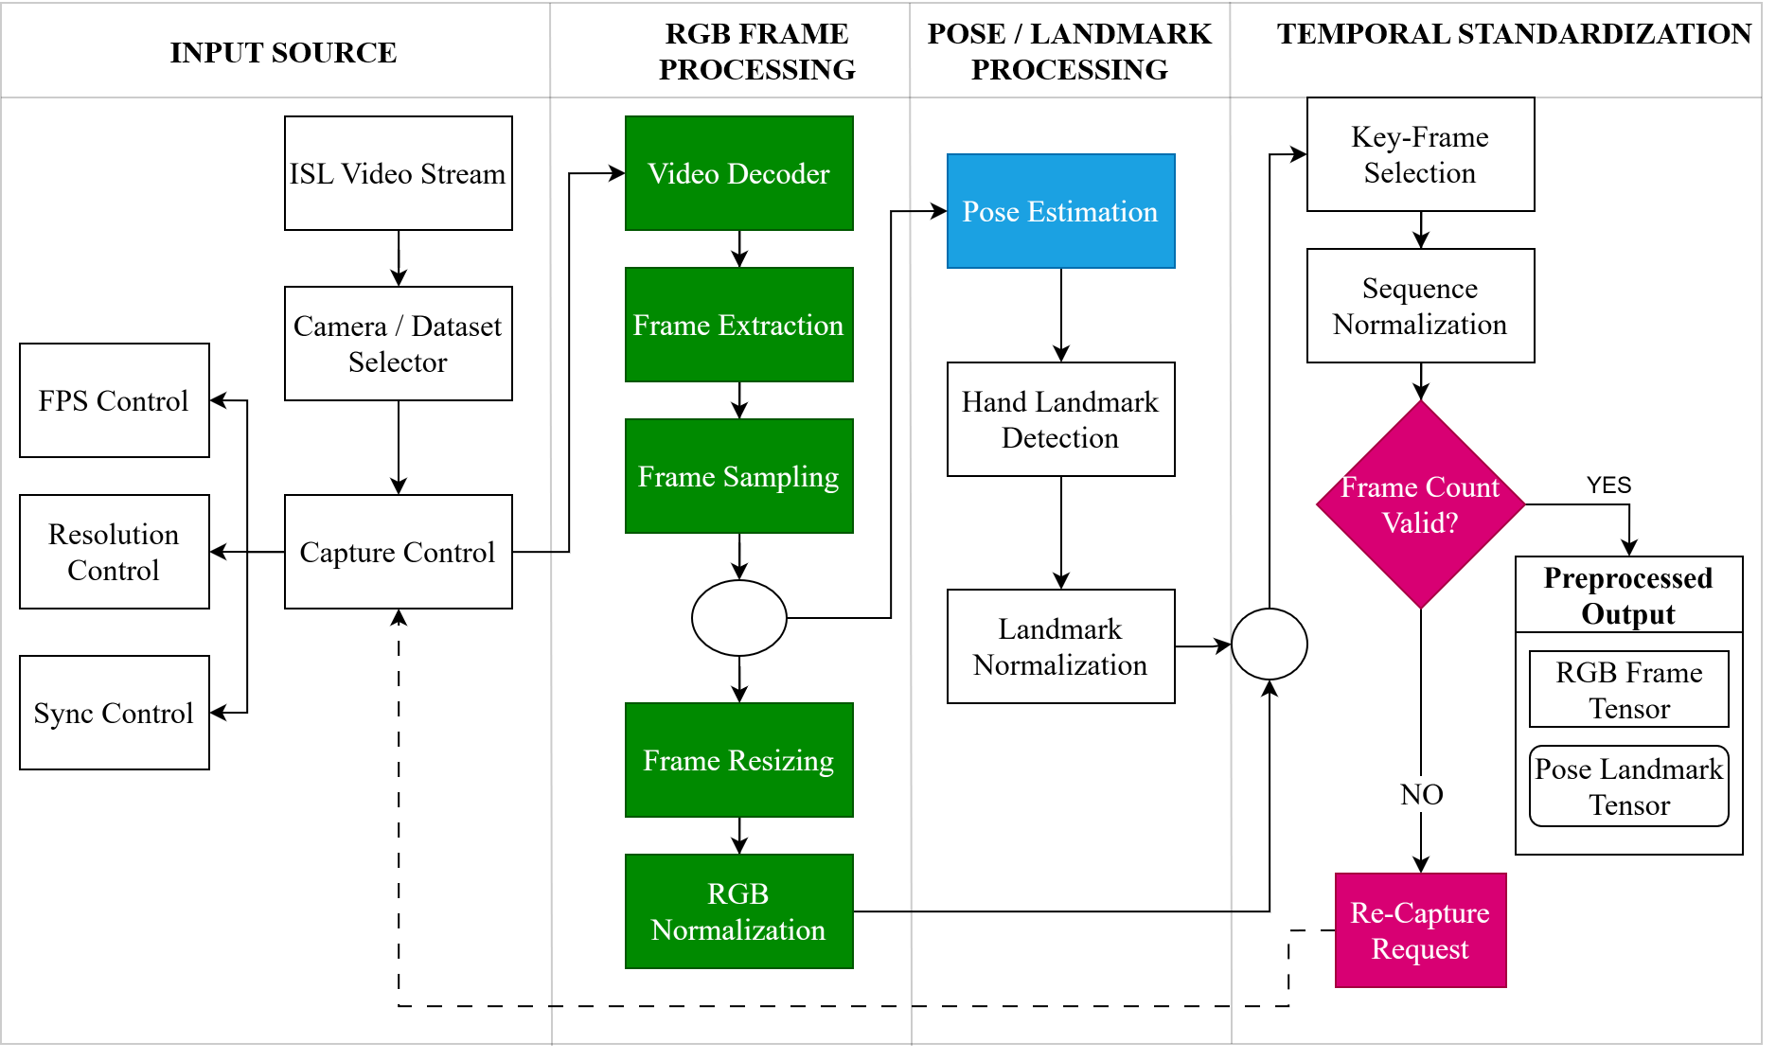

Slide 10
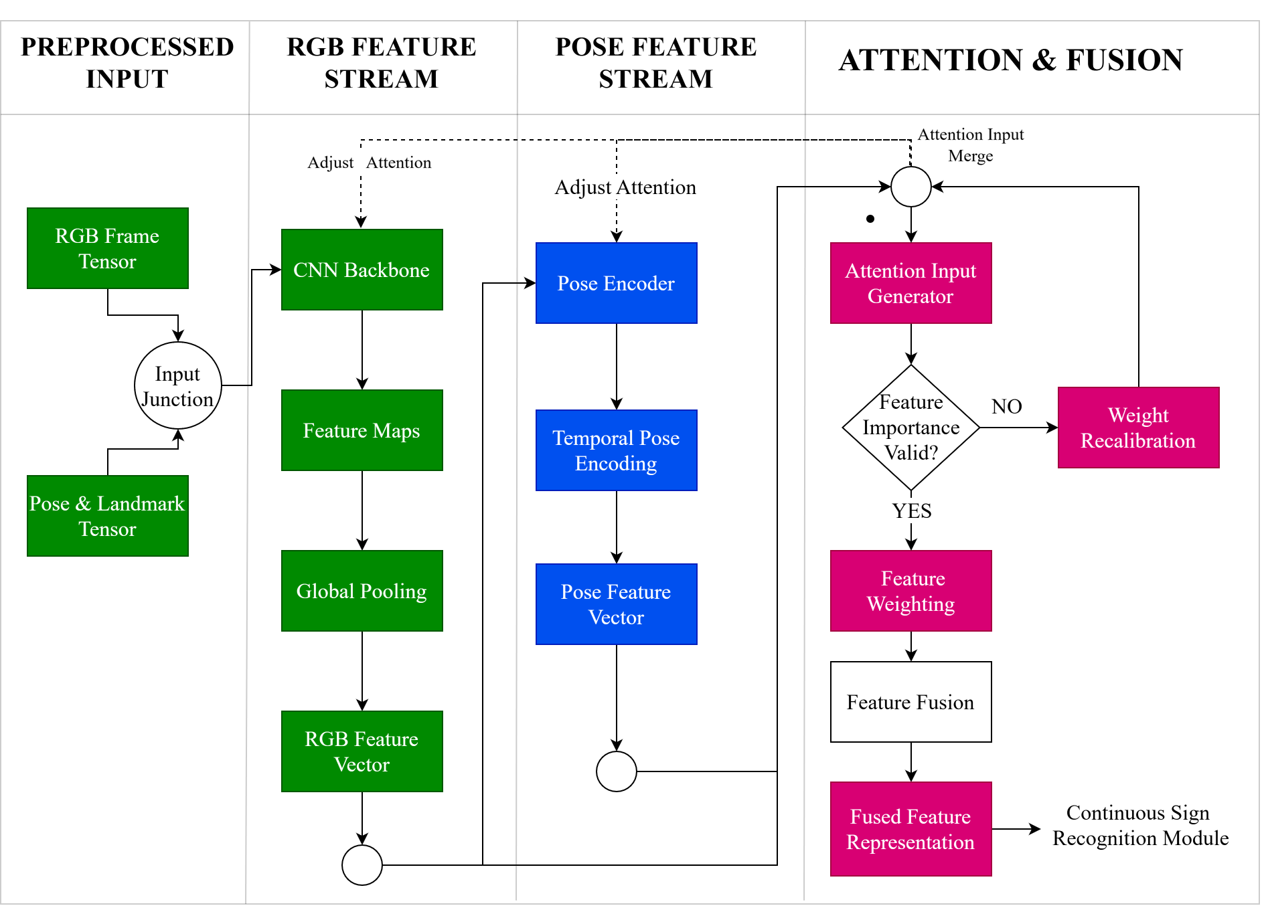

Slide 11
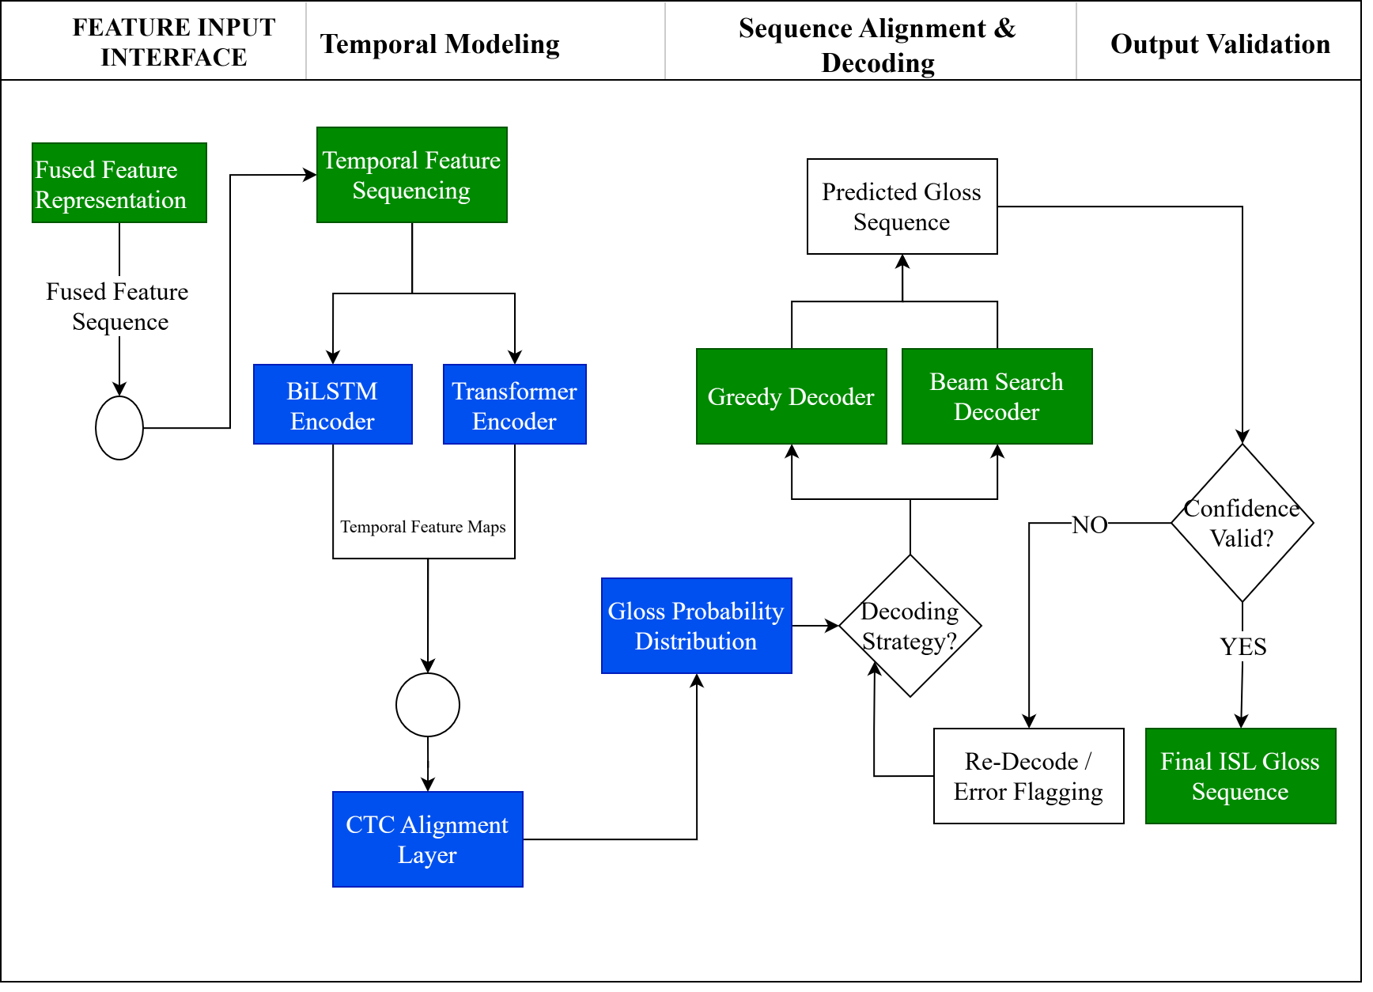

Slide 12
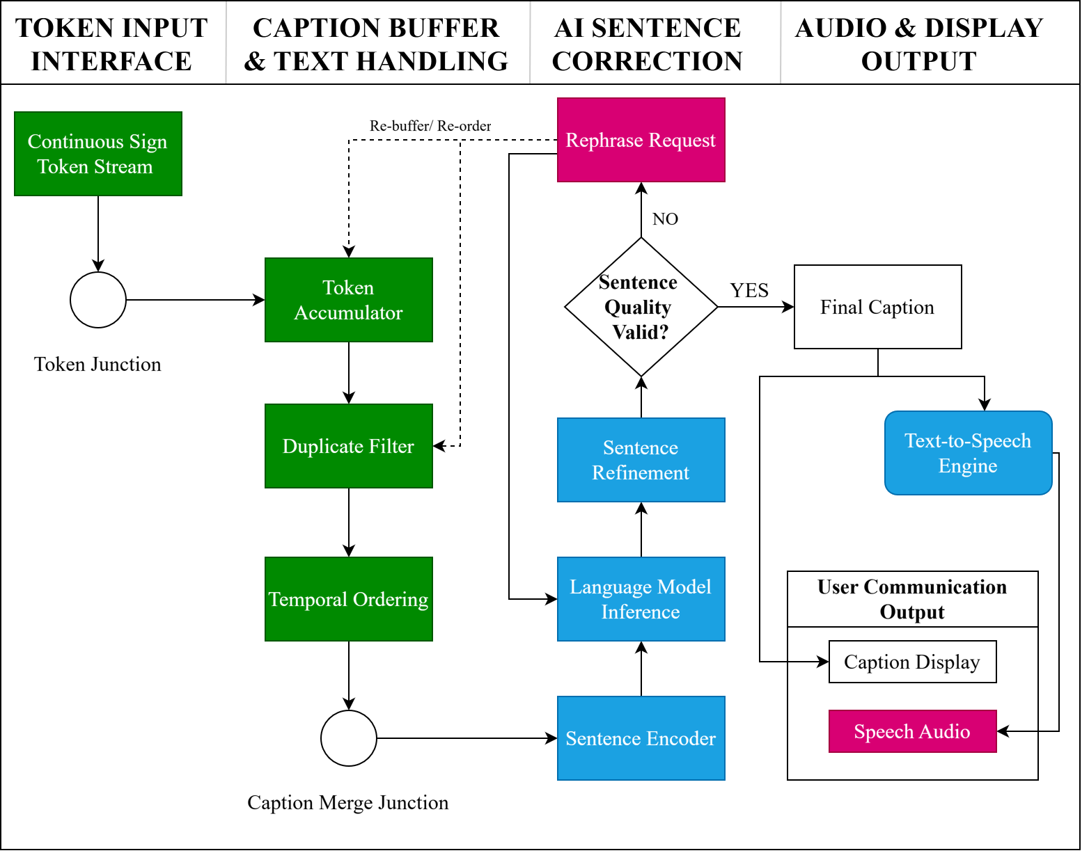

Slide 13
Performance Metrics
Accuracy – Correct recognition of ISL gestures
Precision – Relevance of recognized signs
Recall – Ability to detect all valid signs
F1-Score – Balance between precision and recall
BLEU / ROUGE – Quality of English sentence generation
WER / CER – Error rate in translated output
Latency (ms) – Real-time response performance

Slide 14
Dataset Used
Dataset Description
iSign: A Benchmark for Indian Sign Language Processing
Large-scale ISL–English video–text paired dataset
Contains 118,000+ ISL video–sentence/phrase pairs
Collected from ISLRTC, ISH News and Deaf Enabled Foundation
Covers multiple ISL processing tasks including translation and generation
Key Features
Largest publicly available dataset for Indian Sign Language
Supports ISL → English and English → ISL tasks
Includes signer, background, and motion variations

Slide 15
Deliverables
Working prototype of ISL → English translation
Working prototype of English → ISL translation
Real-time gesture capture and processing
English text and audio output
ISL avatar / video-based output
Model inference using trained backend services

Slide 16
References
[1] A. Joshi et al., “iSign: A Benchmark for Indian Sign Language Processing,”
arXiv preprint arXiv:2407.05404, 2024.
[2] S. Pandey, S. Tahseen, R. Pathak, H. Parveen, and M. Maurya,
“Real-Time Vision-Based Indian Sign Language Translation Using Deep Learning Techniques,”
Int. J. Innov. Res. Comput. Sci. Technol. (IJIRCST),
[3] Y. LeCun, Y. Bengio, and G. Hinton,
“Deep learning,” Nature, vol. 521, no. 7553, pp. 436–444, 2015.
[4] M. Kumar and P. Bhatia,
“A survey on vision-based sign language recognition using deep learning,” IEEE Access, 2024.
[5] H. Li, X. Wang, and Y. Chen,
“Multimodal sign language translation using vision and language models,” Neurocomputing, Elsevier, 2024.
[6] Y. Zhou, Z. Liu, and J. Huang,
“Transformer-based models for multimodal language translation,”
ACM Trans. Multimedia Comput. Commun. Appl., 2024.

